Slide 1
My Personal Chef
Summer Shields
Jewel Loff
Kisha Gladden
Stephanie Balderama

Slide 2
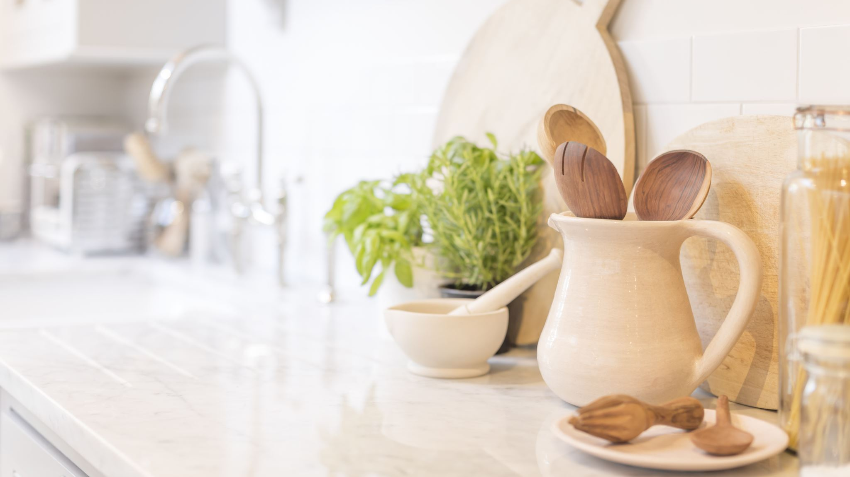
My Personal Chef “Your Health is Your Wealth”
A personalized meal delivery service that means your dietary needs and provides convenient, cost-effective meals delivered to your home, office, or school.
Customized for you, by you.

Slide 3

Overview
Millions of Americans are unable to eat healthy due to busy lives, long working hours, and the need for convenience. Health concerns limit food choices and add complexity to maintaining a healthy diet.
My Personal Chef is a convenient, cost-effective food planning and delivery service offering a dietary solution to meet these challenges. Operated on a subscription service, My Personal Chef, provides meals correlated with your personal health history to reduce conflicts with health conditions and provide personalized choices.

Slide 4
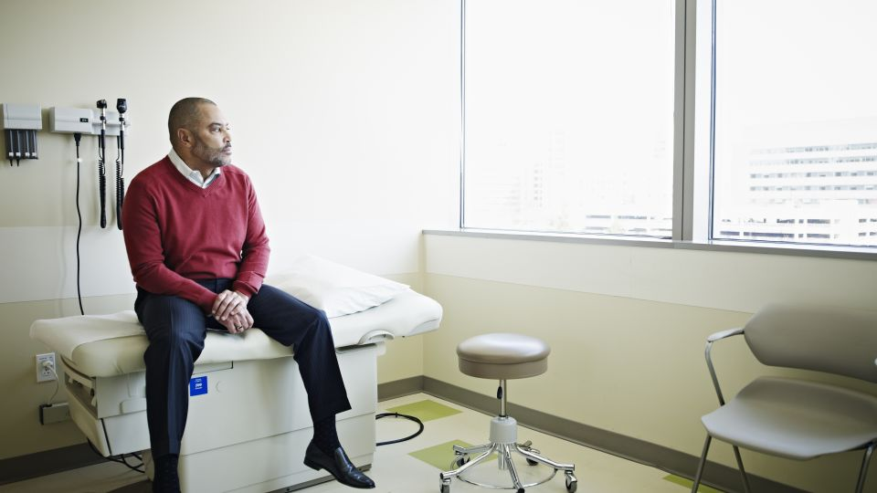
The Problem
Three things are true today:
Americans are busier than ever
People need to do a better job of eating healthy
COVID-19 has forever changed the way we live our lives.
A Pew Research study revealed that both parents in 46% of all two-parent households work full time
The portion of household with a stay-at-home mother declined to 26% in 2017 from 47% in 1970
Nearly 25% of males and 33% of females reported working more than 40 hours per week.
Complications of diabetes, high cholesterol, hypertension are three of the top ten causes of premature mortality. Diet is a significant factor in controlling chronic diseases.
According to the Center for Disease Control, one in ten Americans suffer from diabetes.

Slide 5
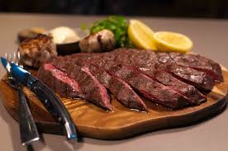
The Solution
The flexibility of My Personal Chef allows our subscribers to:
Create their personalized health profile, including allergies & dietary restrictions.
Receive a personalized list of meal choices for entrees and side dish options.
Wide variety of meal choices eliminates palate fatigue.
Edit meal choices up to 24 hours prior to delivery.

Slide 6

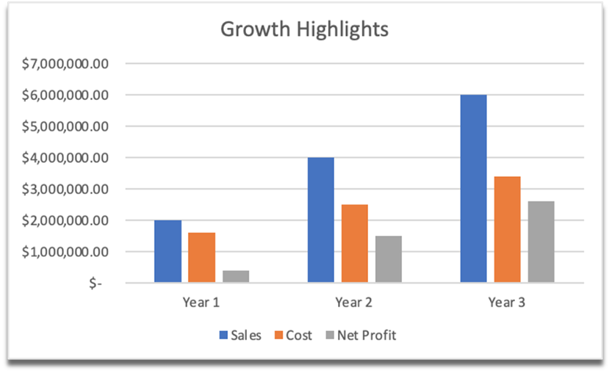
Highlights
Revenue generation $1.2million March-September
Current subscribers of > 1,000
Contracts with 3 major employers/schools:
Wells Fargo Bank
Google
Crossroads High School (private high school)
Success is not an accident, it’s a choice.

Slide 7


Marketing Strategy
Our marketing strategy focuses on the three key benefits of My Personal Chef:
Convenience Wellness Choice

Slide 8

Marketing Plan
Product: My Personal Chef is a convenient food planning /delivery service for busy parents or professionals. Correlates with personal health history to lessen the potential that meals conflict with pre-existing conditions.
Price: For $11 per meal, customers will receive one or two meals per day, five days per week. Subscription price is based on an average of 22 days per month. Subscription pricing for 2 meals per day is $484 per month.
Promotion: My Personal Chef can be found on all social media platforms; Facebook, Instagram and Twitter. Customers can follow these outlets for updates on new ingredients and spices; locations; and products.
Place: Our first ghost kitchen is located in downtown Los Angeles. Service is currently available to any location within a 25-mile radius.
People: Our team members are dedicated to providing nutritious meals, using only the finest ingredients, for our clients. We are happy to answer questions during business hours.

Slide 9
Promotional Advertising

Slide 10

Resources Needed
We are seeking a $1million investment to meet 4 key goals:
Establish 5 additional ghost kitchens in key geographic locations
Expansion into three additional geographic areas
Hire and train 5 marketing representatives to identify and engage additional employers and/or schools
Reach 10,000 subscribers per month

Slide 11


Management Team
Jewel Loff-CEO
Ms. Loff holds a master’s in finance from California State University, Long Beach. She has held senior management positions in the fields of banking, finance, healthcare, and most recently with a start-up technology company.
Summer Shields, CPA-CFO
Mr. Shields has been a licensed Certified Public Account since 2003. Mr. Shields completed his master’s in accounting at Stanford University. He spent 10 years with Deloitte specializing in audits and tax planning. Mr. Shields has served on the board of directors for several small start-up tech firms during the past 5 years.
Kisha Gladden, Chief Marketing Officer
Ms. Gladden holds a master’s in marketing from Harvard University. She has held senior level marketing positions for several marketing and advertising agencies, most recently and Marketing Director for the largest advertising and marketing company in the U.S., where she specialized in marketing of technology companies.
Stephanie Balderama, Chief Sales Officer
Ms. Balderama holds a master’s in finance and marketing from Tulane University. She has been instrumental in the sales success of several large consumer convenience companies. Ms. Balderama previously served as Senior Sales Strategist for a biotech company prior to joining My Personal Chef.

